Slide 1
There was an old lady who swallowed a fly …
(… or, how did we end up here anyway)

Slide 2
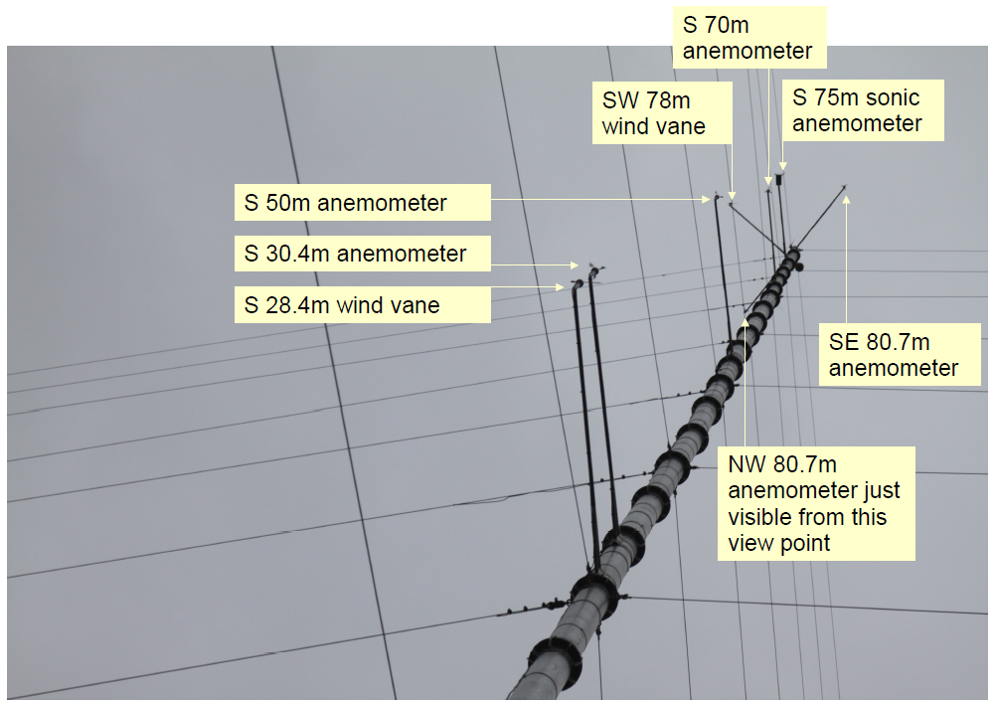
There was an old lady who swallowed a fly …
Limited measurement opportunities

Slide 3
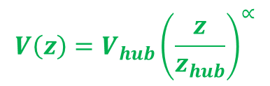
There was an old lady who swallowed a spider …
$$V\left(z\right)=V_{hub}{\left(\frac{z}{z_{hub}}\right)}^{∝}$$
Height / hub height
Approximations to compensate for lack of knowledge, e.g.
Wind shear exponent,
Turbulence intensity
Wind speed / hub height wind speed

Slide 4
There was an old lady who swallowed a horse …
… she’s dead, of course.
Solutions that are over-constrained by the original problem can lead to bigger problems

Slide 5
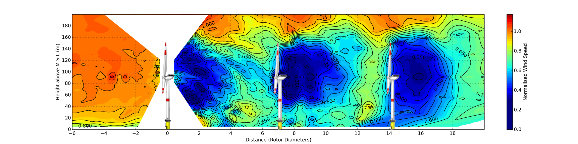
There was an old lady who didn’t swallow a fly …
(… or, what would we do if we started from scratch)
Eolics: equally sophisticated
Measurements
Models of atmospheric conditions and wind turbine response
Scientific rigour and predictive power is possible

Slide 7
Epistemology and the eolicist
My knowledge is incomplete
The incompleteness of my knowledge extends to my knowledge of its incompleteness
I don’t know what I don’t know
Do you know what I don’t know I don’t know?
We cannot predict what we can learn from each other
Measure, discuss, disagree … learn

Slide 8
Compression zone
Energy
Energy
Energy
Compression zone

Slide 9
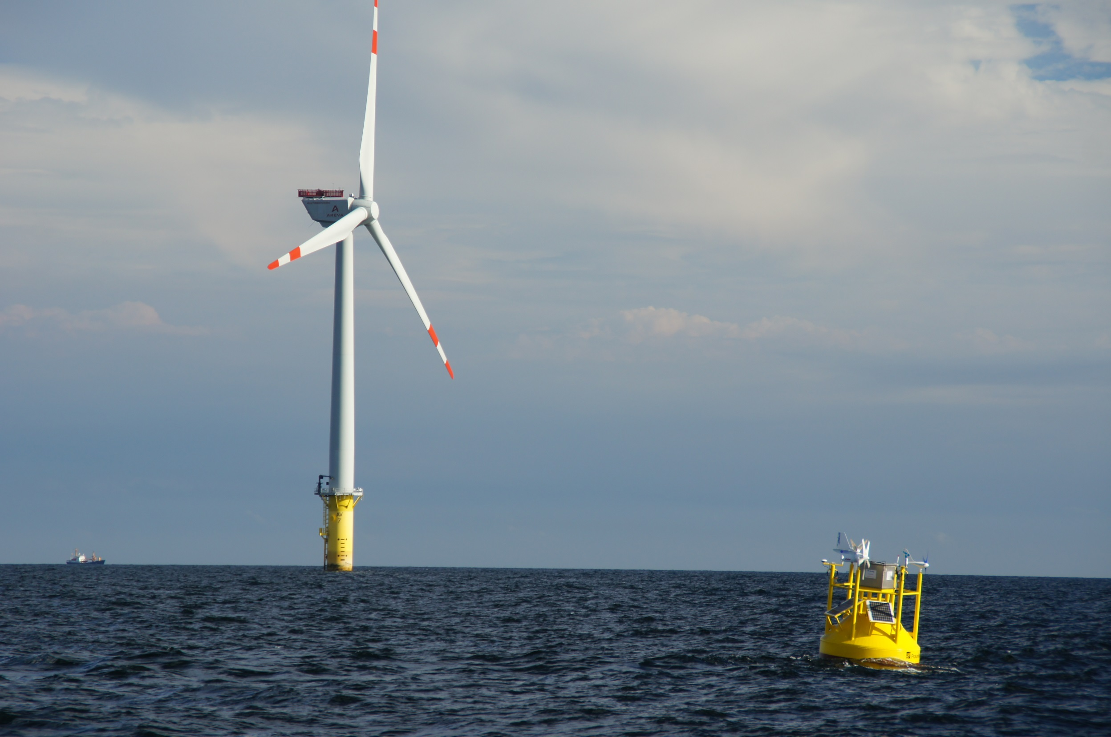
© Gerrit Wolken-Möhlmann, Fraunhofer IWES

Slide 10

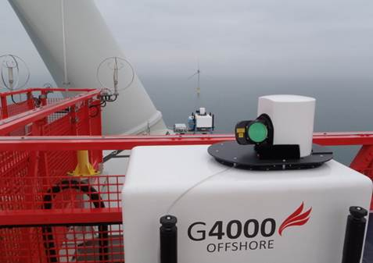
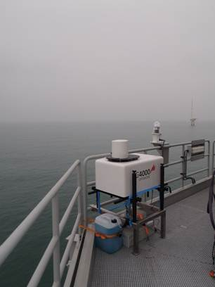
Galion G4000 Offshore on transition piece
2 x Galion G4000 Offshore on nacelle, one facing forward to survey inflow, one facing back for wakes
© Gerrit Wolken-Möhlmann, Fraunhofer IWES

Slide 11
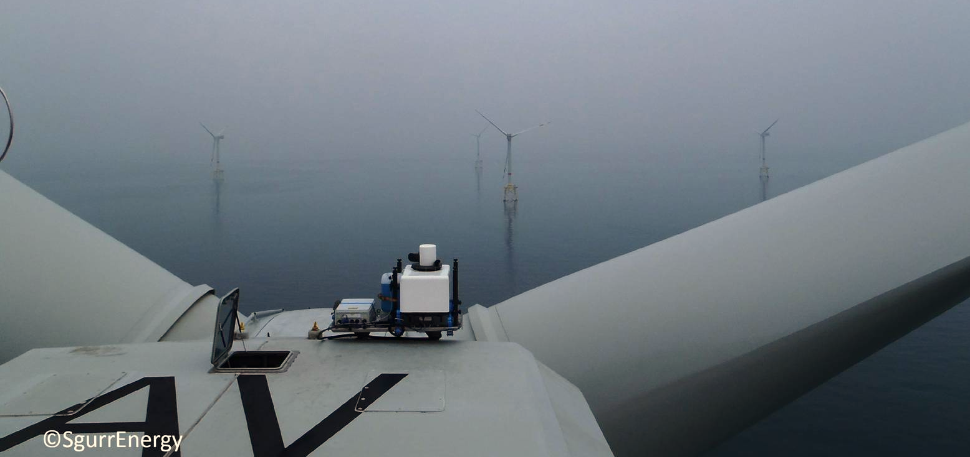
Unit G24
Compression zone

Slide 12
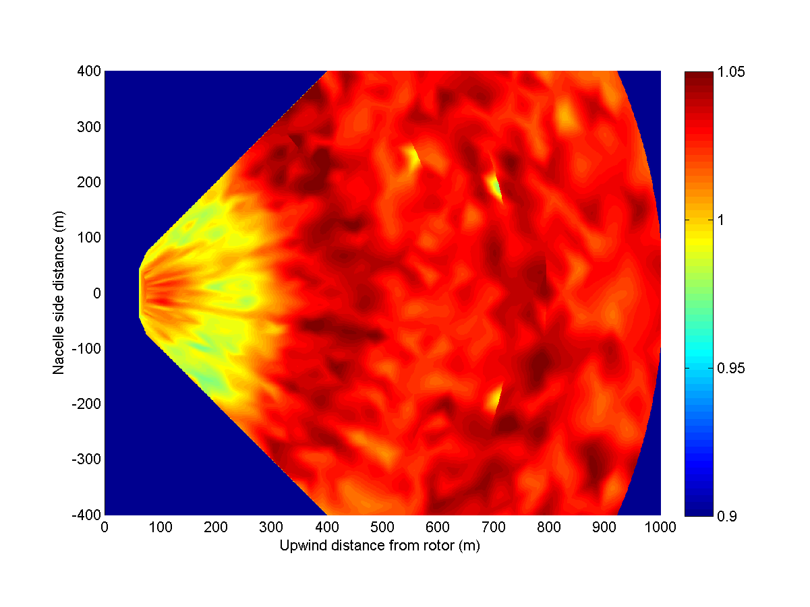
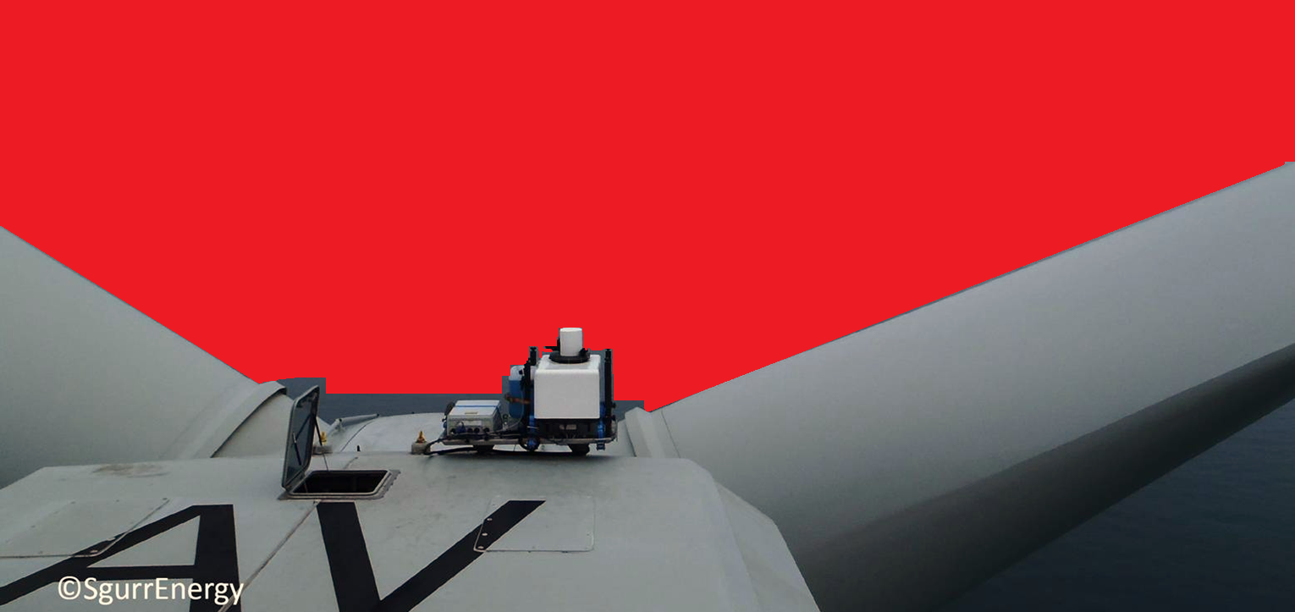
Compression zone

Slide 13
Compression zone at 5m/s

Slide 14
Compression zone
Nacelle lidar
Free stream
2.5D = 100%

Slide 15
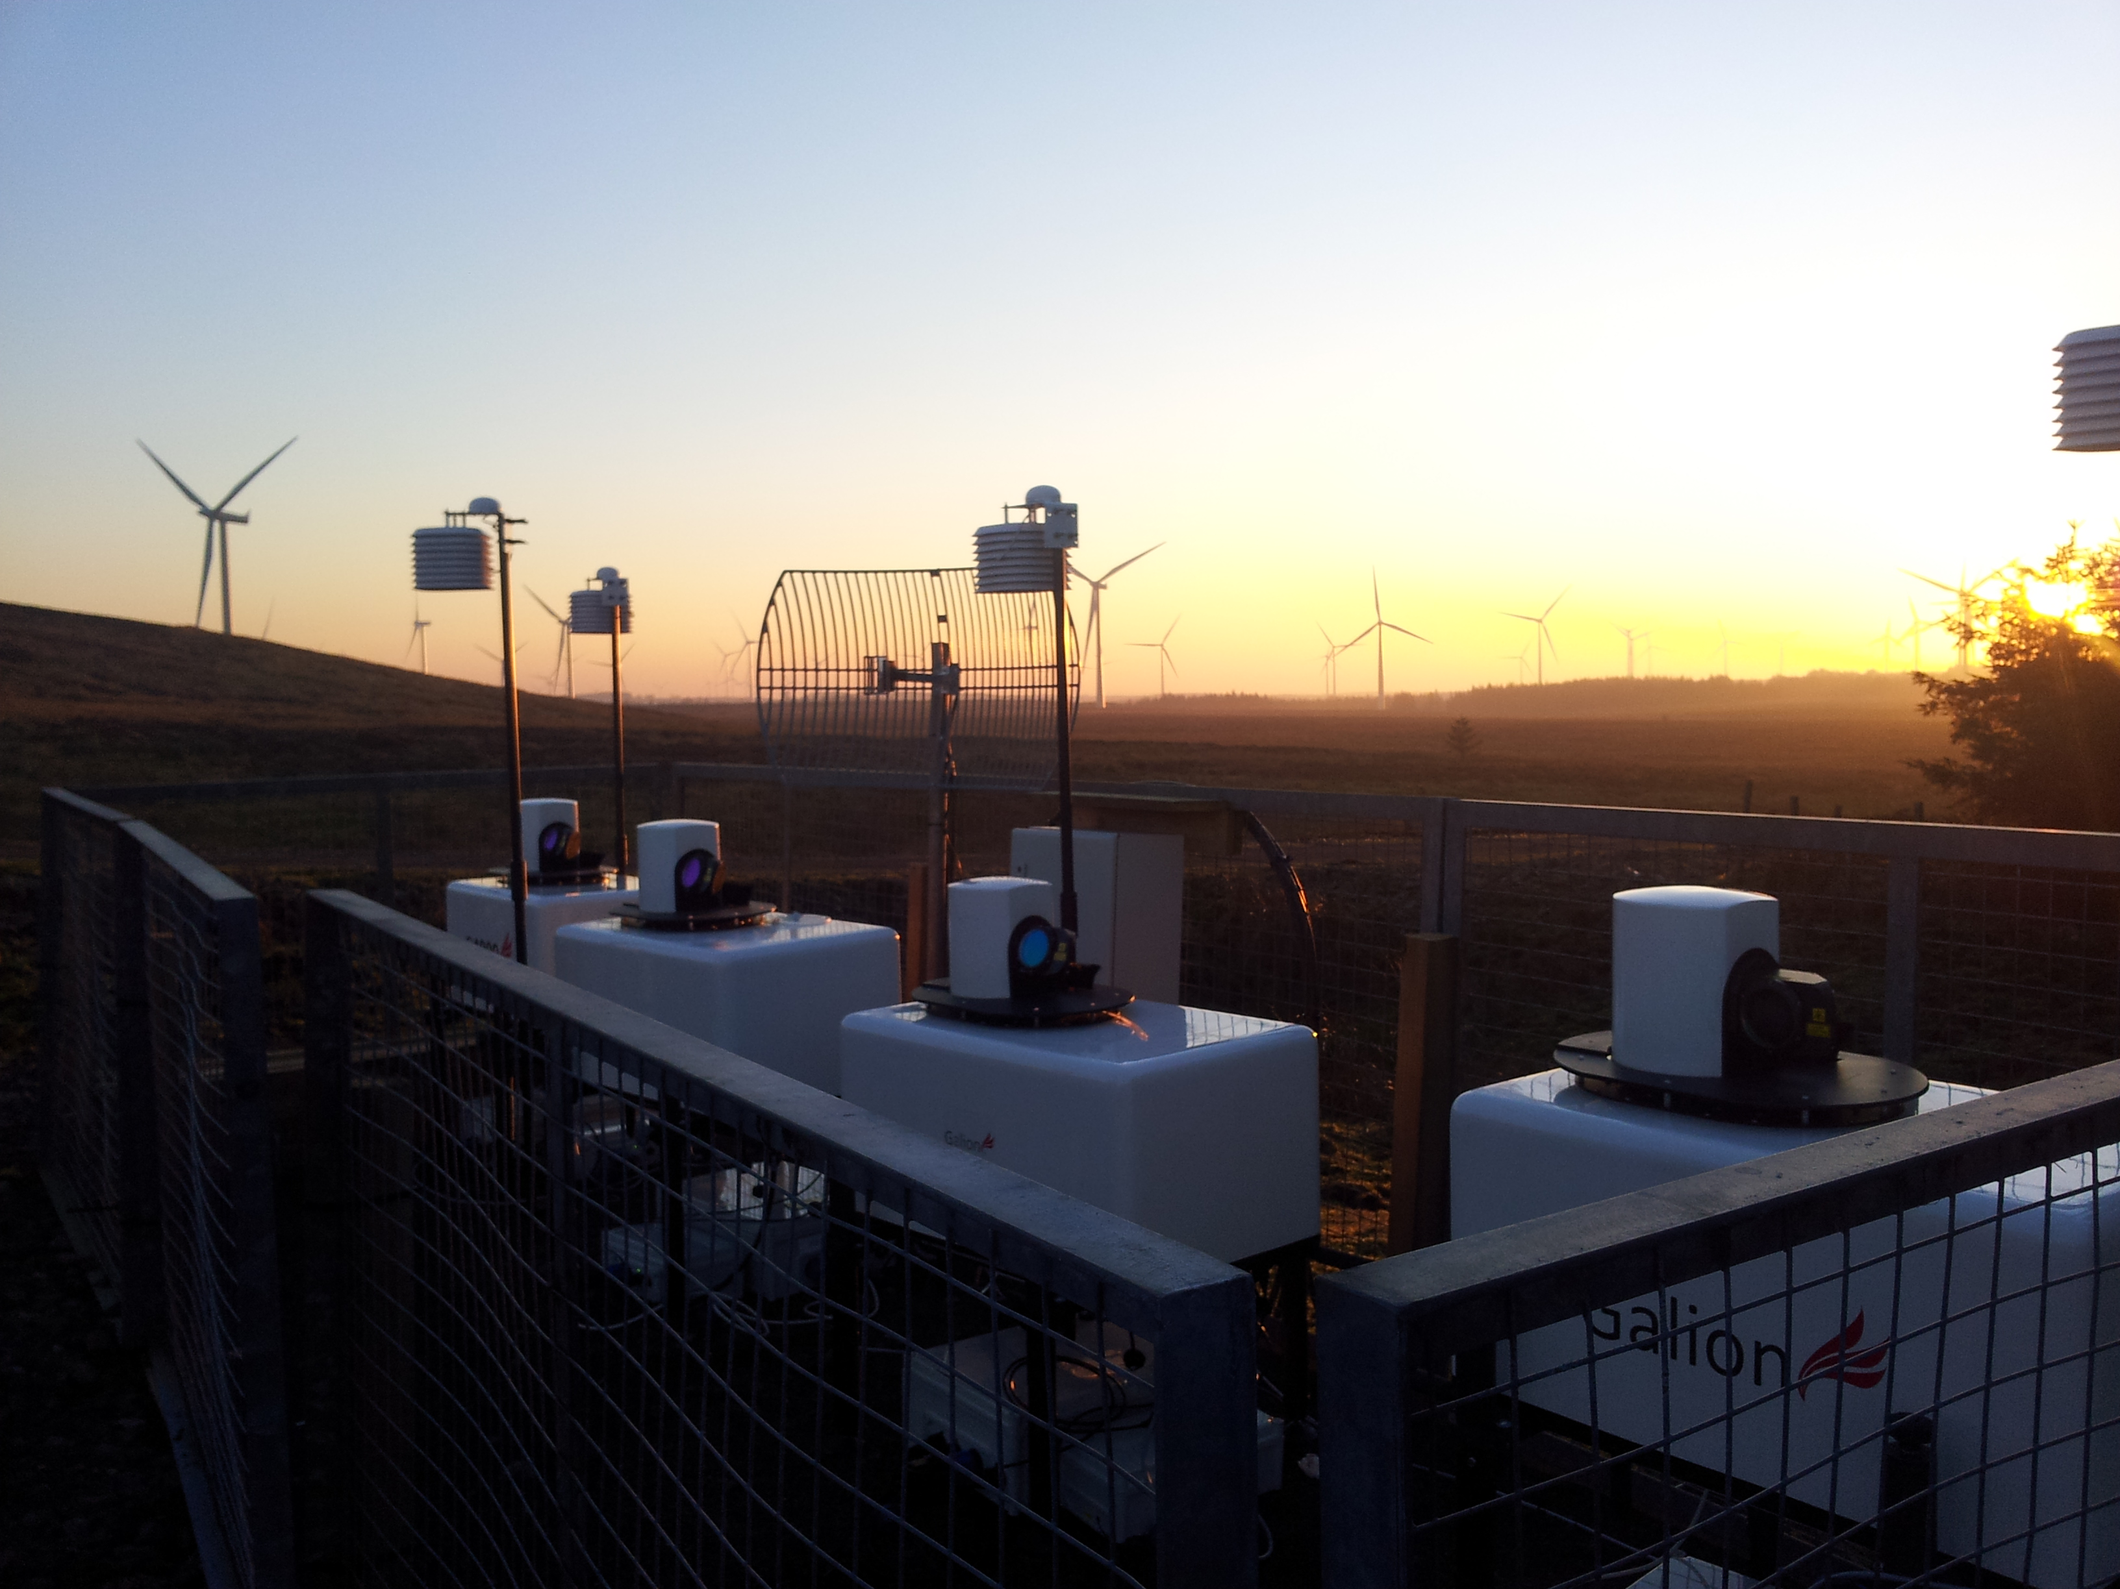
Convergent scan geometries

Slide 16
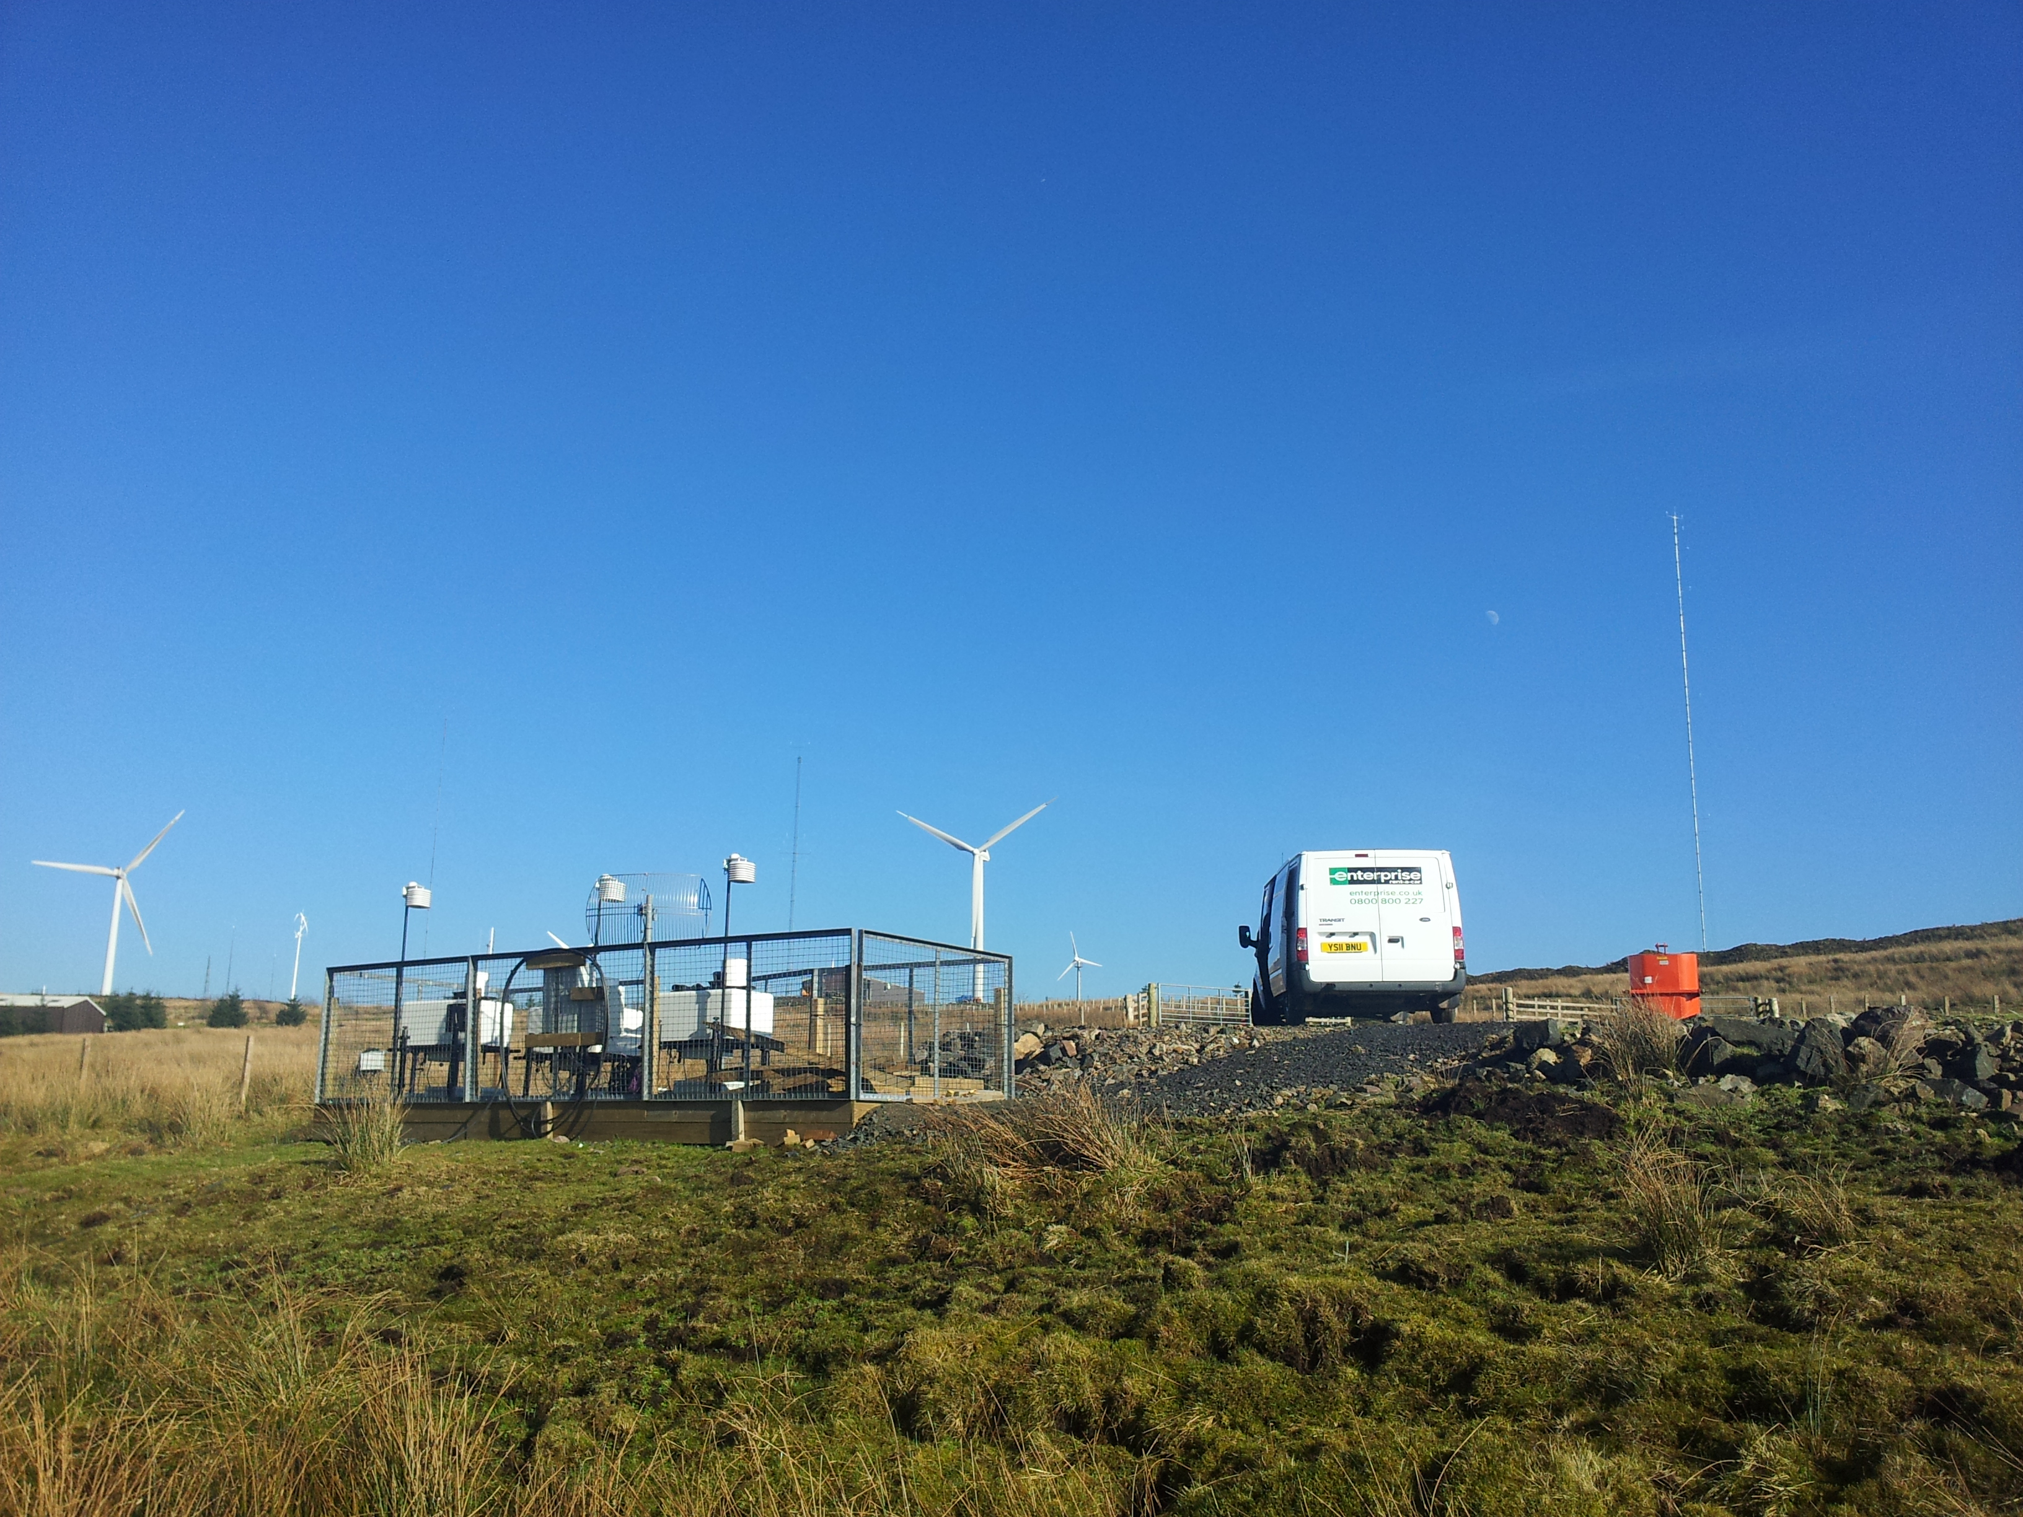
Convergent scan geometries
Mast

Slide 17
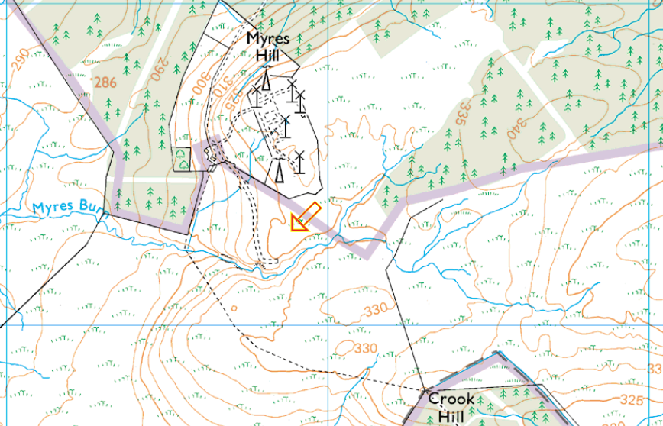
TB1
Mast
TB2

Slide 18
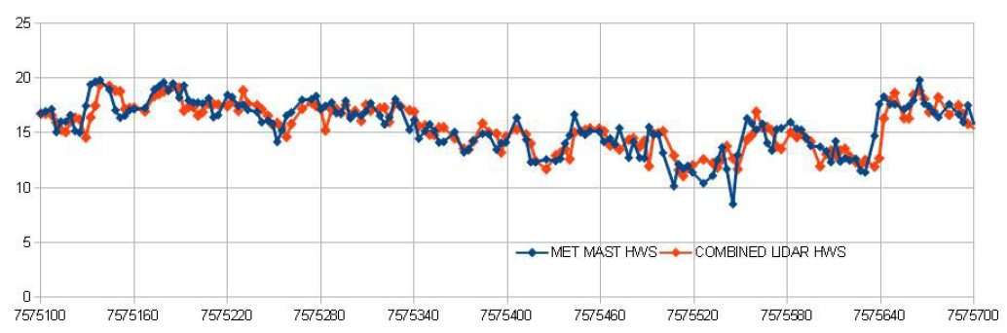
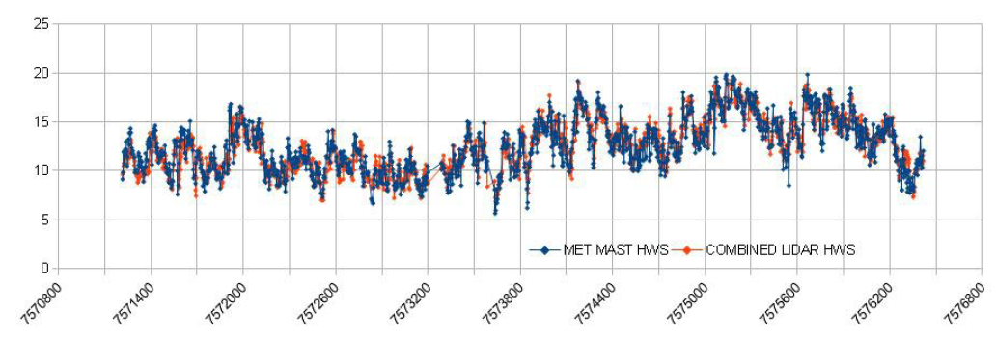
Convergent scan geometries

Slide 19
Convergent scan geometries

Slide 20
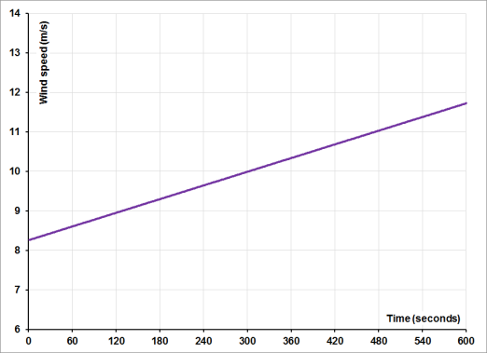
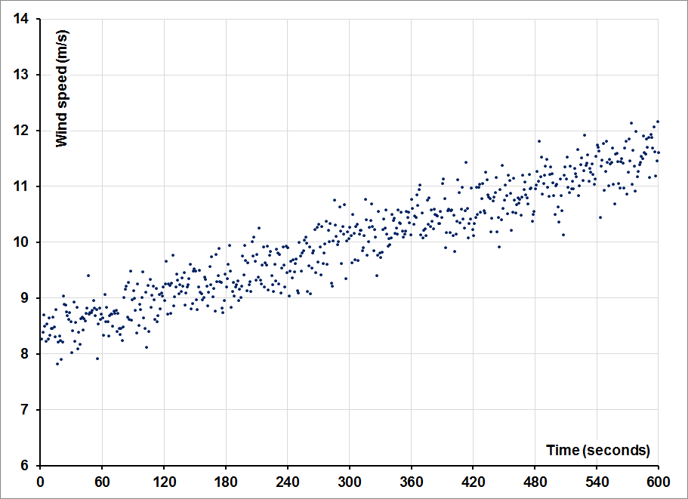
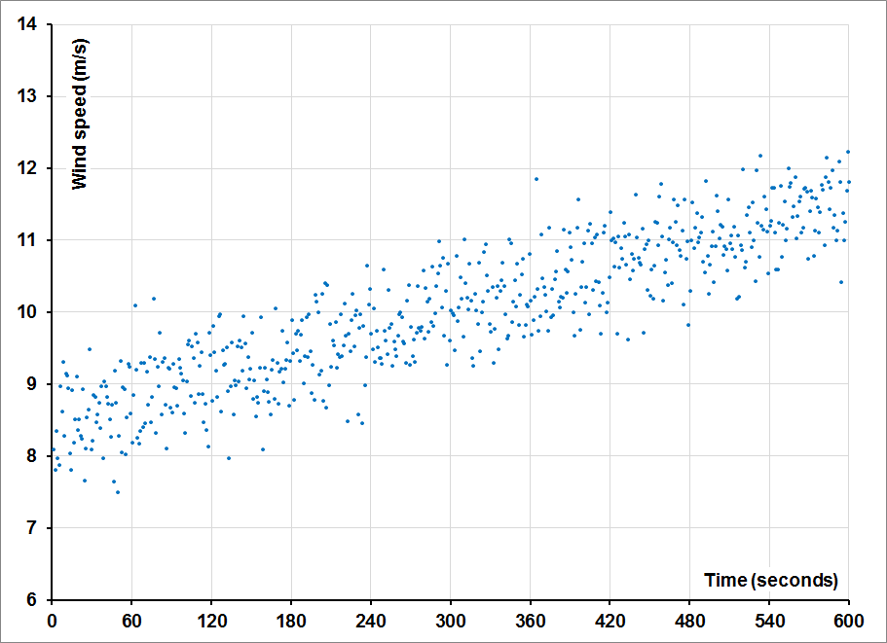
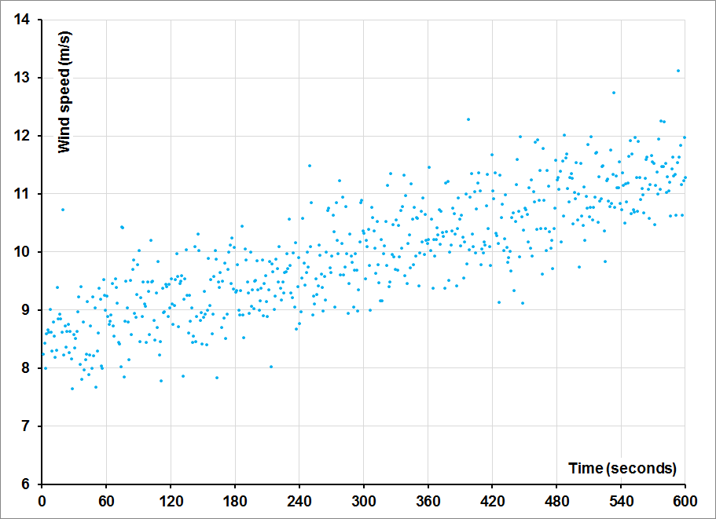
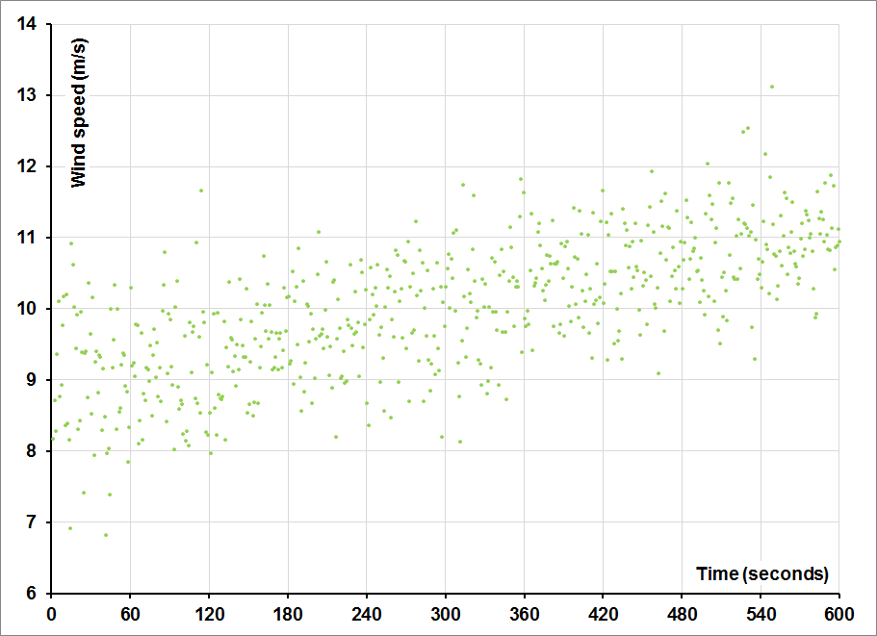
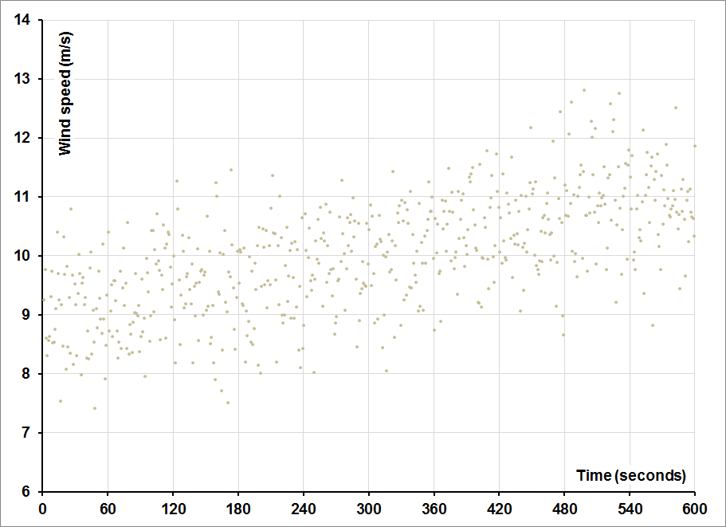
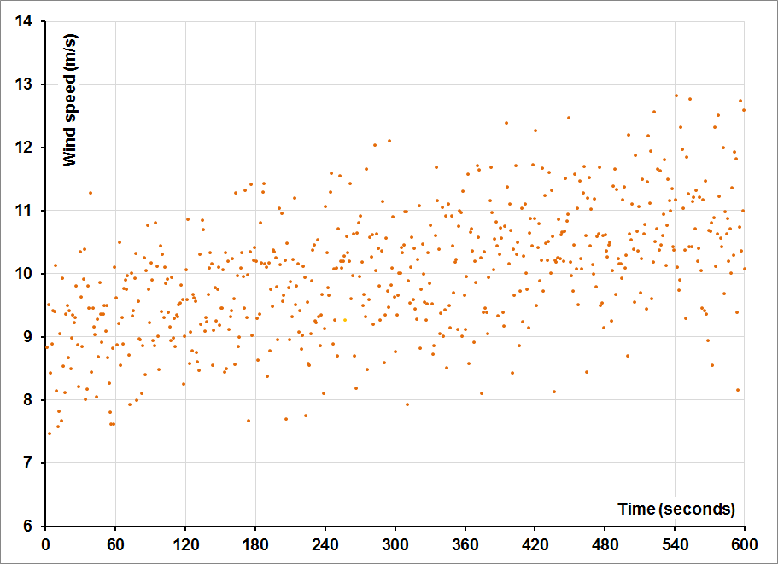
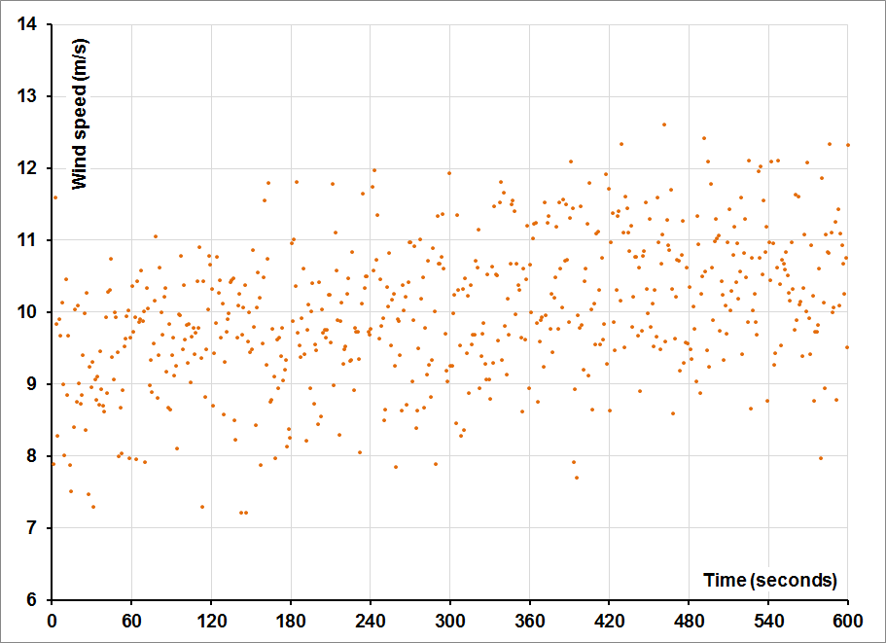
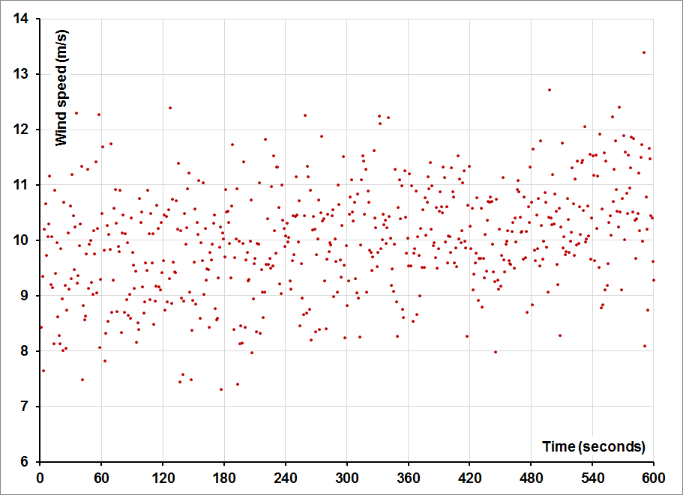
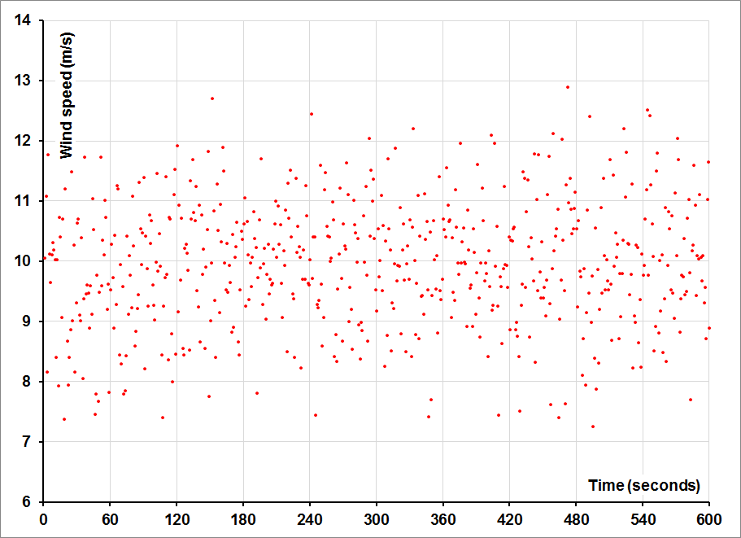
The problem with turbulence intensity
Linear ramp
Random Gaussian

Slide 21
Transience versus Variance

